Slide 1
Random Forest Algorithm
Random Decision Forest Algorithm(Classification)

Slide 2
Classification
Supervised Learning
Regression
Unsupervised Learning
Machine Learning
Random Forest Classification
Reinforcement Learning

Slide 3
Why Random Forest:-
Why do we need this Algorithm?
What are its advantages?

Slide 4
No Overfitting
High Accuracy
Wide Applications
Low Bias
Low Variance
Runs Efficiently on Large Dataset.
Accurate Predictions.
Recommendation Systems.
Health
Why Random Forest Algorithm?

Slide 5
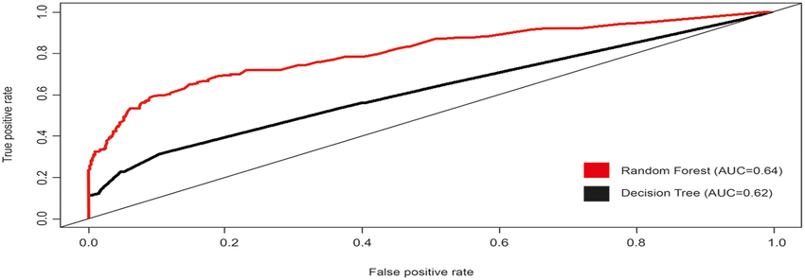
ROC curve for Decision Tree and Random Forest:-

Slide 6
What is Random Forest Classification?
Random Forest is a method that operates by constructing multiple Decision Trees during training phase.
Ensemble Learning
Bagging
Boosting
Random Forest
(Bootstrap-Aggregation)

Slide 7
Steps Involved:-
Step 1: Pick at random K data points from Training set.
Step 2: Build the Decision Tree associated to these K data points.
Step 3: Choose the the number of trees you want to build and repeat STEPS 1 & 2.
Step 4: For a new data point, make each one of your tree predict the category to which the data points belongs, and assign the new data point to the category that wins the majority votes.

Slide 8
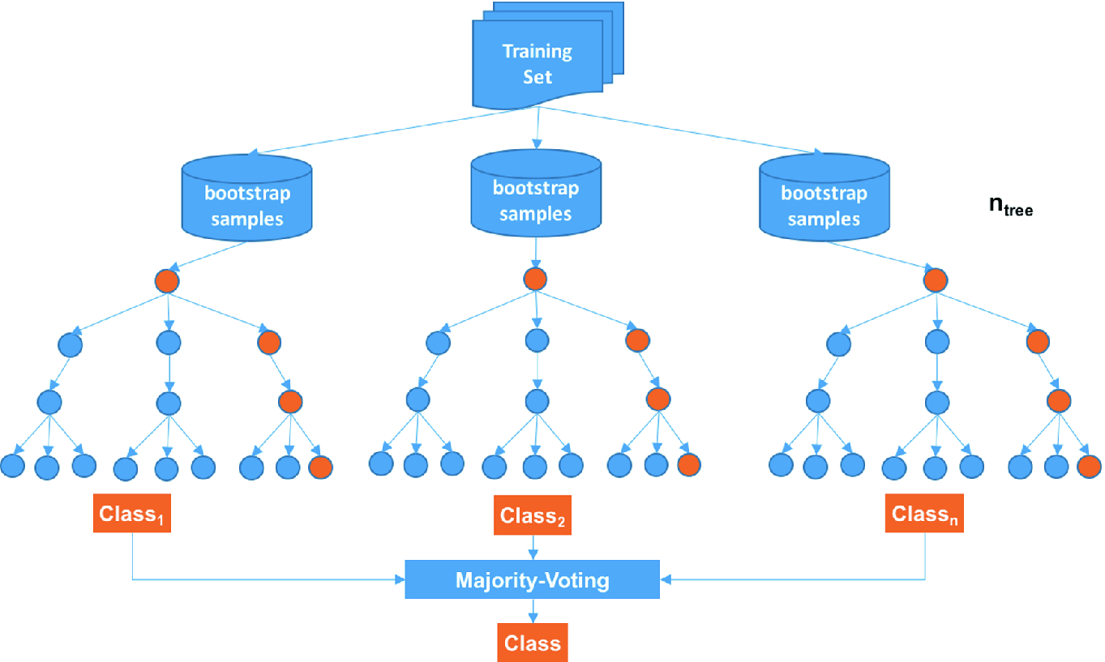

Slide 9
More about Random Forest:-
The Ensemble learning Bagging technique(Bootstrap-Aggregation) makes the model free from Overfitting and give accurate predictions.
Random Forest has a property of Row Sampling(Sub-Samples of Dataset).

Slide 10
Example:-
Classification model to predict the class:-
Dataset-
Color | Diameter | Season | Label
Red | 3 | Winter | Apple
Yellow | 3 | Summer | Lemon
Red | 1 | Winter | Cherry
Yellow | 3 | Summer | Lemon
Red | 3 | Winter | Apple
Red | 1 | Winter | Cherry

Slide 11
Decision Tree 1:-
D(Apple, Lemon, Cherry)
Is Diameter>=3 ?
False True
Cherry
D(Apple,Lemon)
Is Color Yellow ?
False True
Apple
Lemon

Slide 12
Decision Tree 2:-
D(Apple, Lemon, Cherry)
Is Color Red ?
False True
Lemon
D(Apple,Lemon)
Is Diameter >=3 ?
False True
Cherry
Apple

Slide 13
Decision Tree 3:-
D(Apple, Lemon, Cherry)
Is Diameter =1 ?
True False
Cherry
D(Apple,Lemon)
Is Grown in Summer ?
False True
Apple
Lemon

Slide 14
Let’s classify the new observation
Color=Red,Diameter=1 and Season=Winter
After considering the class prediction of above Decision Trees
Decision Tree 1- Cherry
Decision Tree 2- Cherry
Decision Tree 3- Cherry
The final predicted class is Cherry.

Slide 15
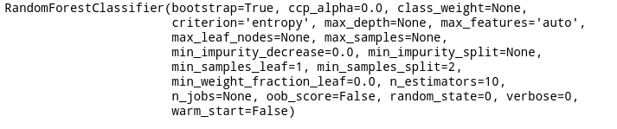
sklearn.ensemble.RandomForestClassifier

